Slide 1
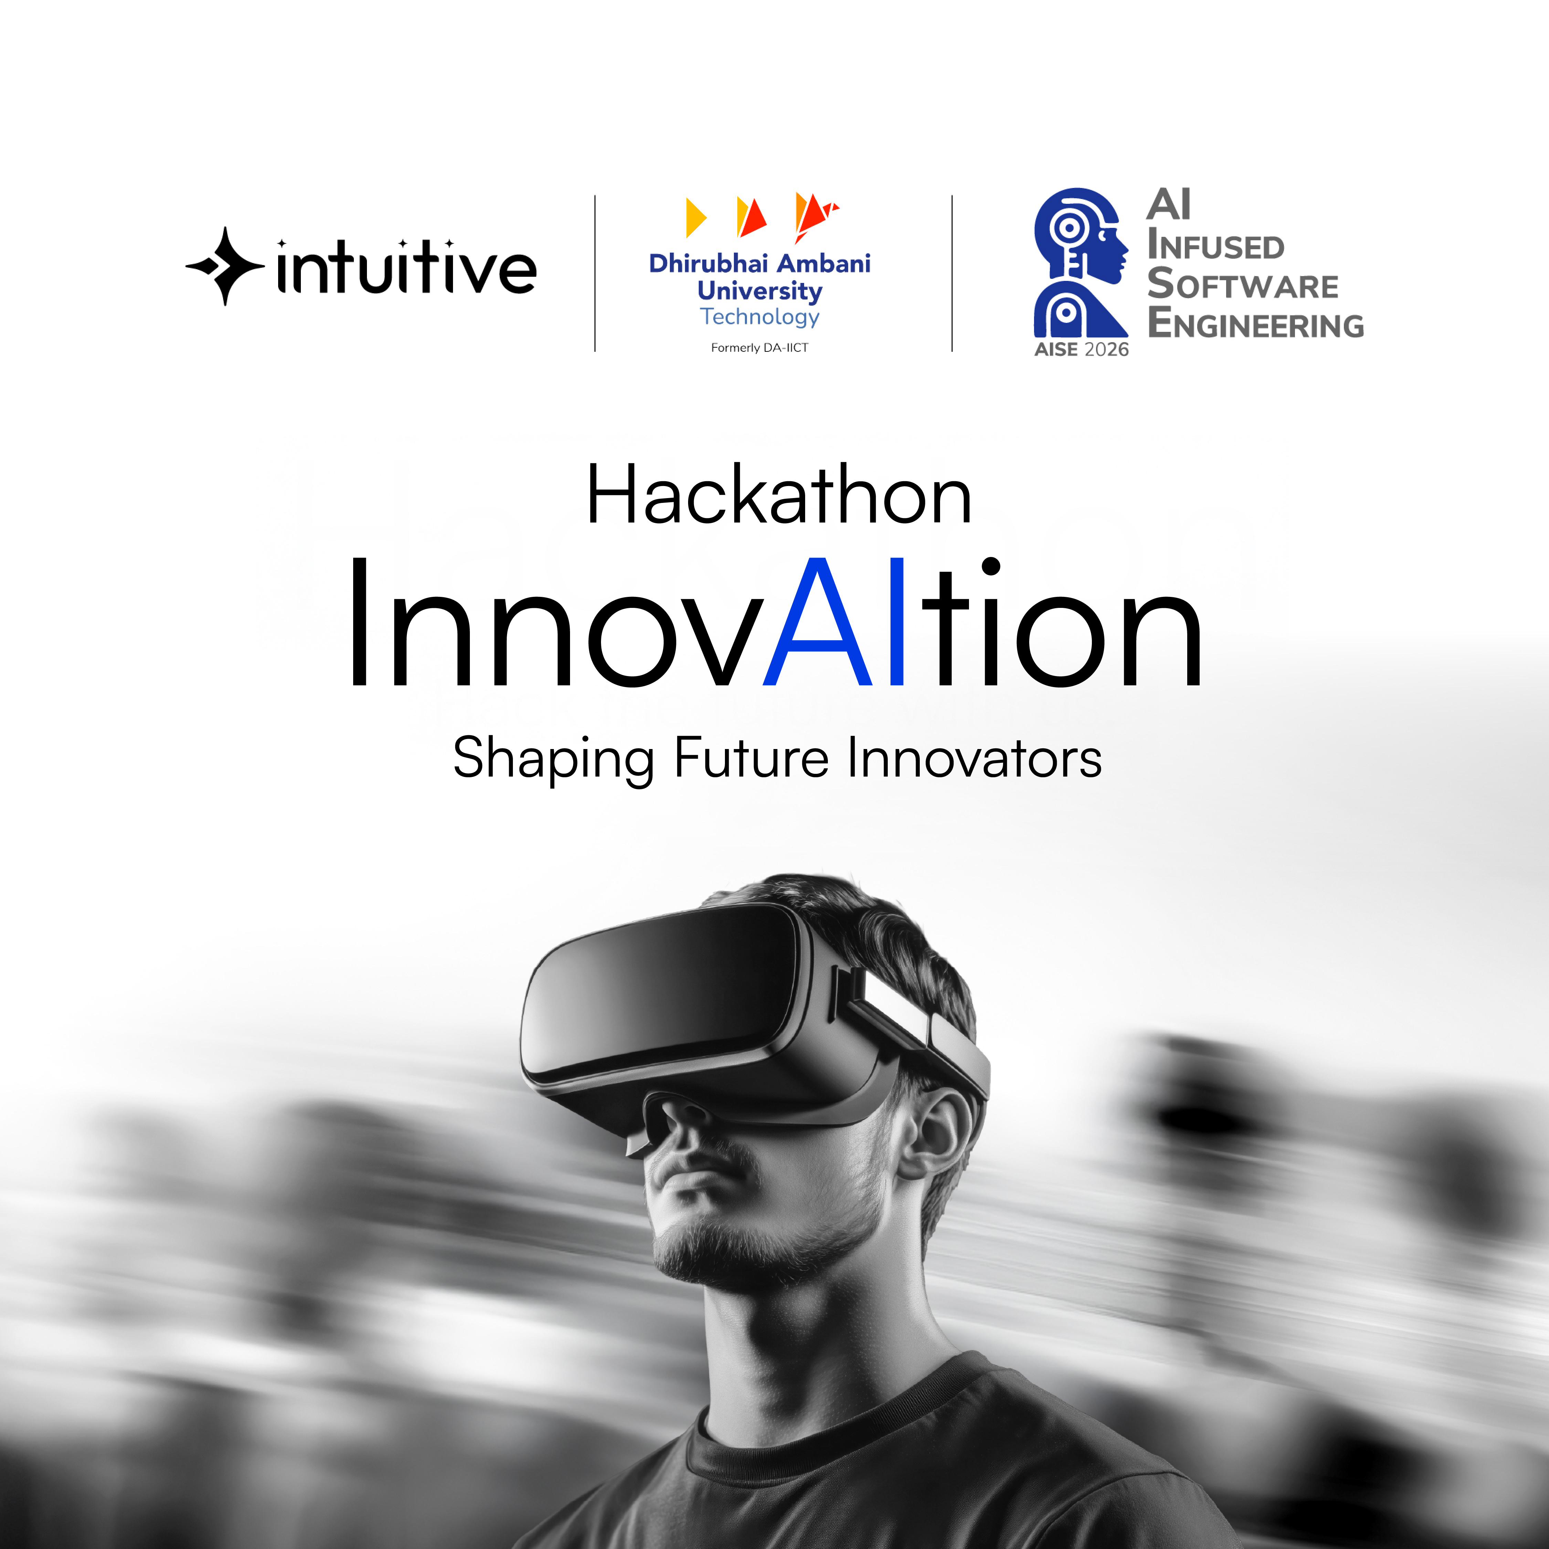
Team Name :Heisenberg
Problem Statement Title :AI-Driven Infrastructure Diagram & IaC Code Generator
Domain :Large Language Models (LLMs) and Generative AI
Team Lead :Manav Merja

Slide 2
Idea Description
The Problem:
Complexity Overload: Cloud consoles (AWS) have thousands of services, making them overwhelming for students and beginners.
Steep Learning Curve: Mastering "Infrastructure as Code" (Terraform) takes months of practice.
Visualization Gap: Developers struggle to visualize how services connect (e.g., EC2 to RDS) without manual drawing tools
The Solution: Nebula Cloud
Natural Language to Cloud: We built an intelligent interface where users type simple English (e.g., "Create a secure web server"), and the AI generates a Visual Architecture Diagram automatically.
Instant Code Generation: Alongside the visual diagram, the system instantly generates production-ready Terraform Code.
Two-Way Synchronization: Unlike ChatGPT, our tool offers a "Full Control Loop"—change the diagram, and the code updates; change the code, and the diagram updates.
"Reducing cloud setup time from hours to seconds"

Slide 3
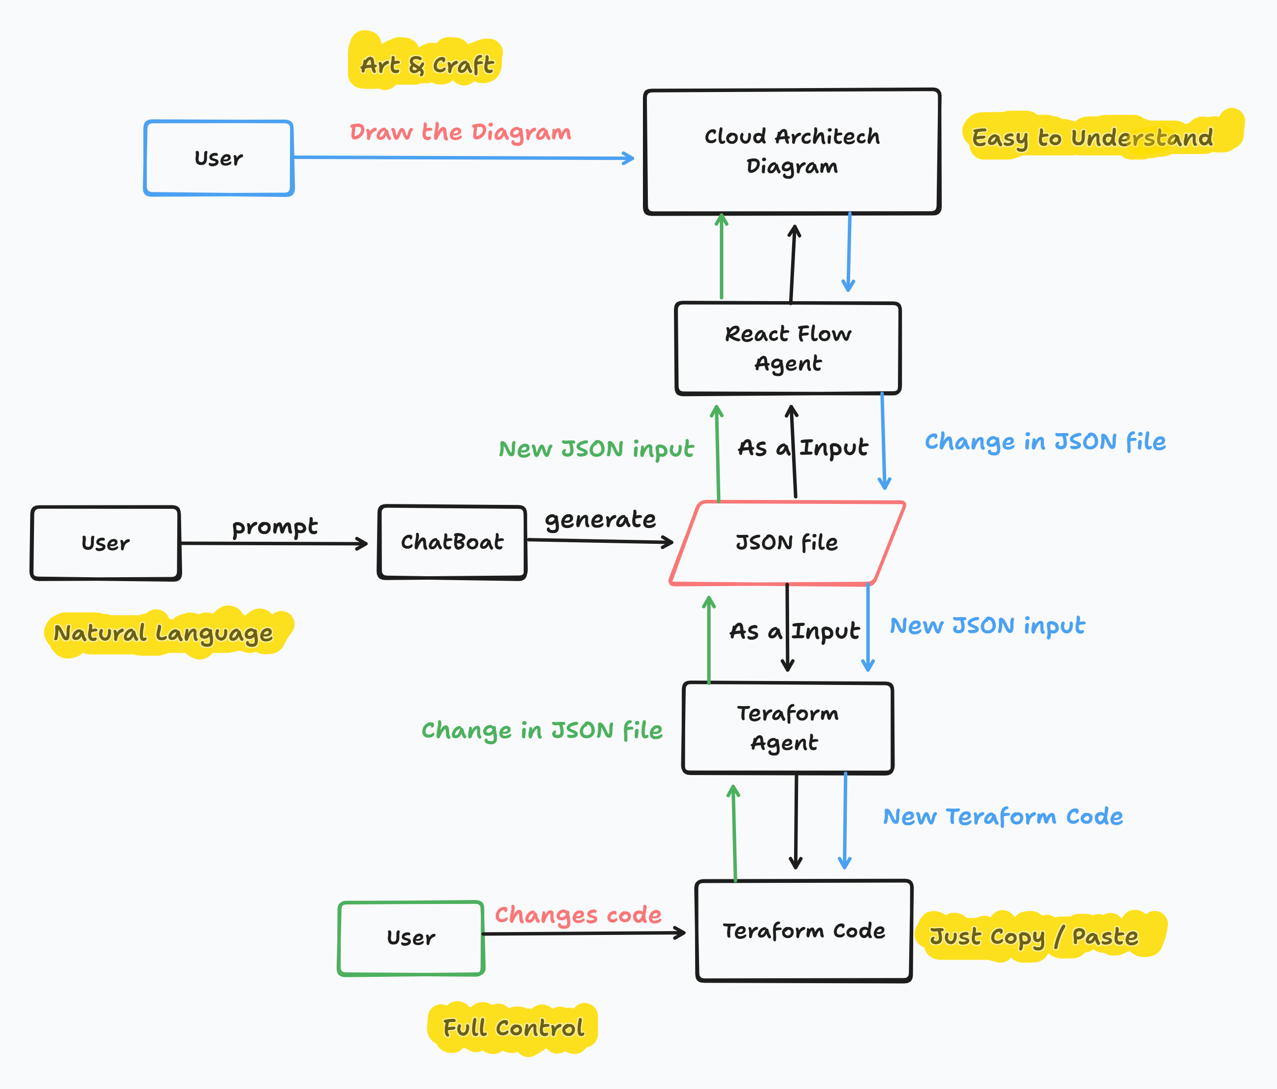
Objectives:
Automate Design: Reduce cloud architecture design time from hours to seconds using NLP.
Interactive Learning: Provide a drag-and-drop canvas (React Flow) to help students learn cloud concepts visually.
Production Ready: Generate valid, deployable Terraform code directly from the visual design.
Objective & Prototype
Step 4: Terraform Agent generates the HCL code.
Prototype Workflow:
Step 1: User inputs prompt.
Step 2: Python Backend (FastAPI) converts prompt to JSON Structure using LangChain.
Step 3: React Flow Agent renders the interactive diagram.
Step 4: Terraform Agent generates the HCL code.
Sync Logic:Any manual edit in Visuals triggers an auto-update in Code (and vice-versa).

Slide 4
Feasibility
Technical Implementation: We have implemented a scalable Microservices Architecture:
Frontend (The Canvas): Built with Next.js and React Flow for high-performance rendering. Hosted on Vercel.
Backend (The Brain): Python FastAPI server hosted on Hugging Face Spaces (Dockerized Container).
AI Engine: Powered by LangChain orchestration using Groq (Llama 3) for ultra-fast inference and Hugging Face Inference API as a fallback.
Data Validation: Uses Pydantic to ensure generated configurations are strictly valid.
Why is it Feasible?
1. Technical Feasibility
Visual Feedback Loop: Unlike chat-only tools, Nebula bridges the gap between design and code, technically solving the "Black Box" problem of AI generation.
2. Operational Feasibility
Broad Usability: Zero-barrier adoption makes it instantly usable for Students, Developers, and Educational Institutes for learning and prototyping.
User-Centric Design: Automated "Drag-and-Drop" interface reduces the manual effort and error rate associated with traditional cloud setups.
3. Market Feasibility
Education Sector Demand: Strong potential in EdTech for simulating cloud environments without incurring high AWS bills.
Growth Potential: Directly addresses the steep learning curve for junior developers and the rapid prototyping needs of startups.

Slide 5
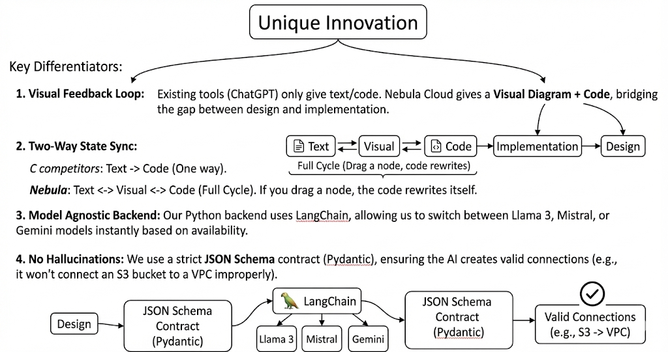
Unique Innovation
Key Differentiators:
1. Visual Feedback Loop:
Existing tools (ChatGPT) only give text/code. Nebula Cloud gives a Visual Diagram + Code, bridging the gap between design and implementation.
2. Two-Way State Sync:
C ompetitors: Text -> Code (One way).
Nebula: Text <-> Visual <-> Code (Full Cycle). If you drag a node, the code rewrites itself.
3. Model Agnostic Backend: Our Python backend uses LangChain, allowing us to switch between Llama 3, Mistral, or Gemini models instantly based on availability.
4. No Hallucinations: We use a strict JSON Schema contract (Pydantic), ensuring the AI creates valid connections (e.g., it won't connect an S3 bucket to a VPC improperly).

Slide 6
Team Member Details
Member Name | Role | Degree | Semester
Manav Merja | Full Stack Developer & ML Developer | B. Tech | 4
Dev Jivani | Frontend Developer | B.Tech | 4
Bhagav Rakholiya | Full Stack Developer | B.Tech | 4

